Slide 1
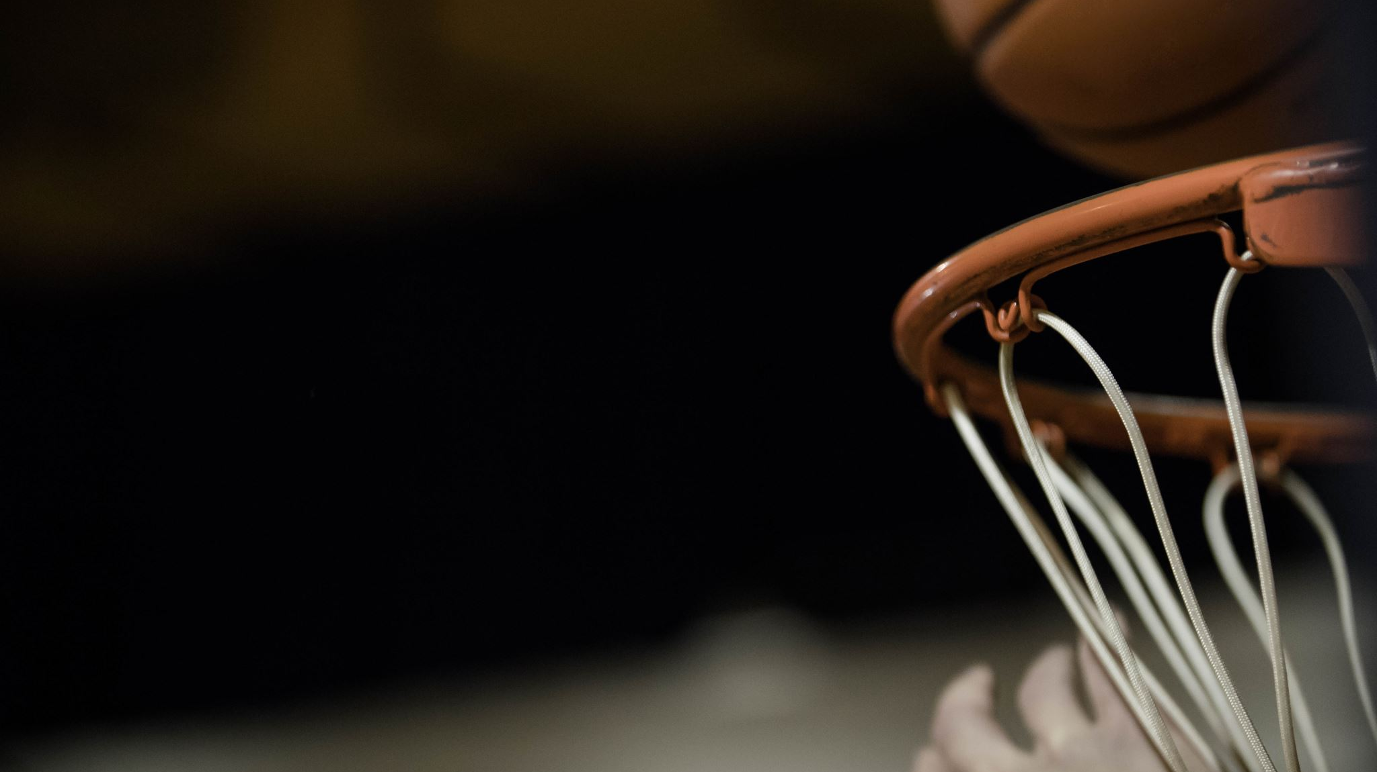
Predicting Bets on the NBA Season
Cole, Hunter, Taylor, Ryan, Talon

Slide 2


Background
Betting has become increasingly popular since the legalization of it across many different states in the US
Betting from your phone as grown with the improvement of technology as well
Most NBA bets are placed using the American Odds system which gives a value positive or negative to determine your money won
EX: +100 or Even would win you your wagered amount, -200 would win you half of your wagered amount, +200 would win you double your wagered amount
One of the more popular bets is betting on the Over/Under of total points in an NBA game
Sportsbooks set a number like 215.5 and as a bettor you decide if the total point will be over or under that amount

Slide 3
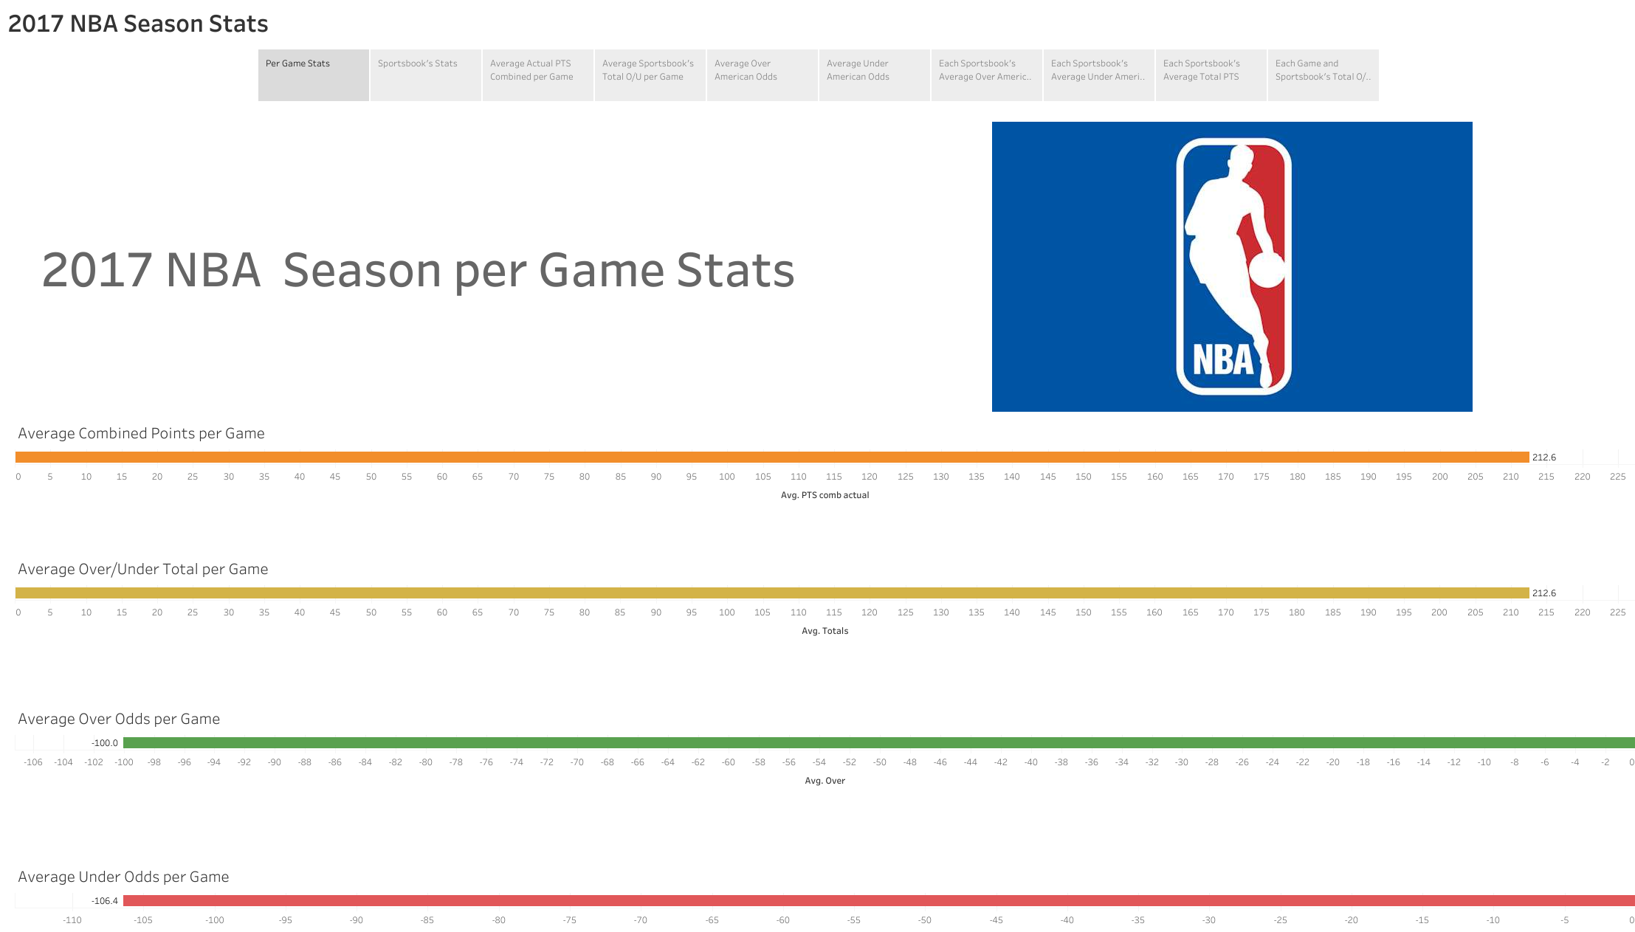

Slide 4
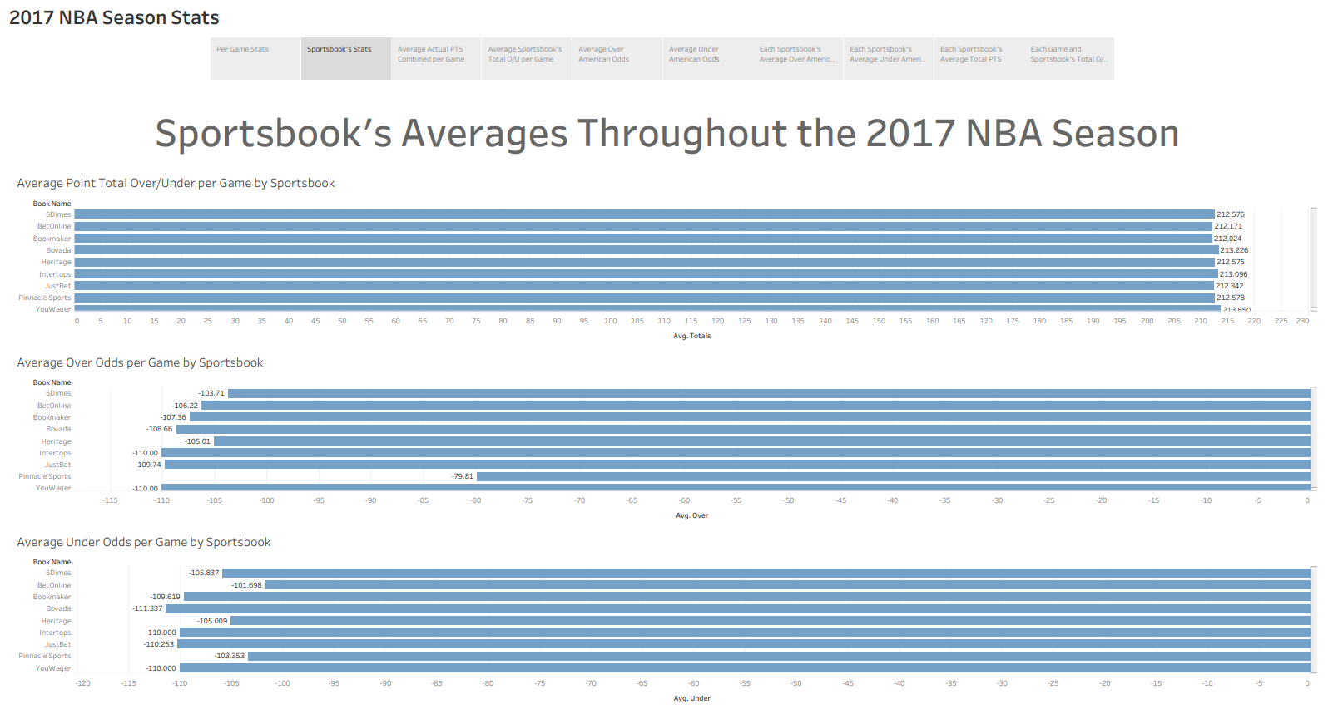

Slide 5
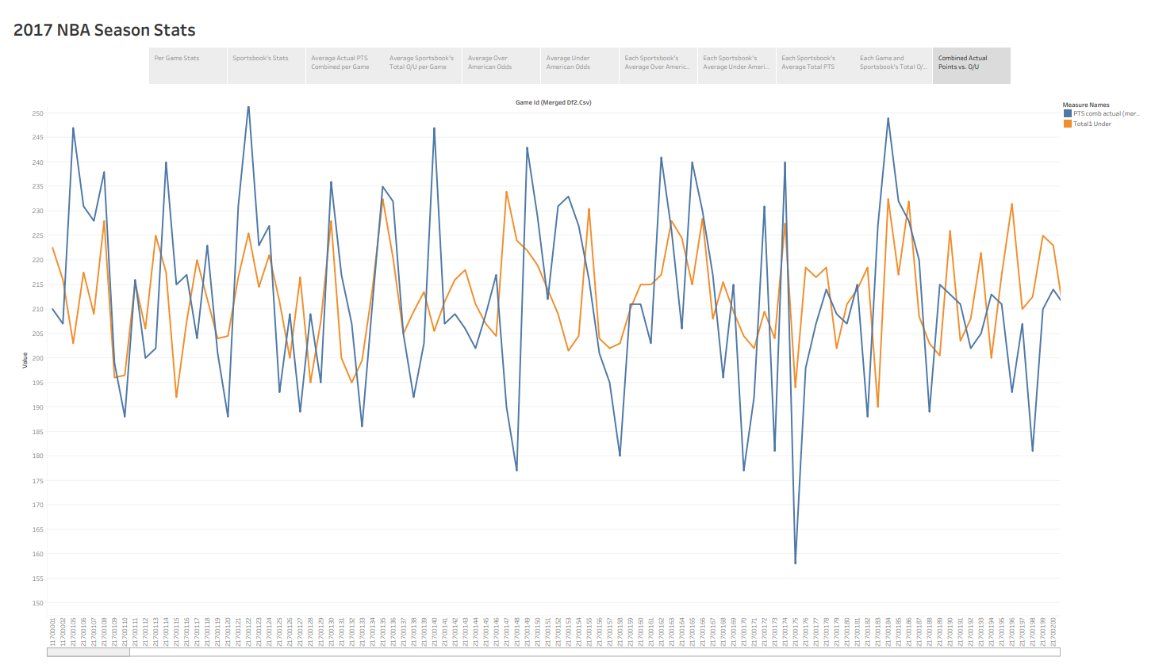

Slide 6

Data Development
Added a column that gave us the actual points combined
Added columns for each team’s last 10 games
Rolling Average for Points for and against
Added columns that told us if the bet that won was an over or an under
These columns were crucial for our model’s predictions
Ignored columns on FG%, FG3%, and Rebound%
These columns could be beneficial for future models or other model frameworks

Slide 7

Possible Flaws
Player Suspensions, Injuries, or Rest Days
Refs are unpredictable and change game to game
Players have hot and cold streaks
Tanking in the NBA

Slide 8
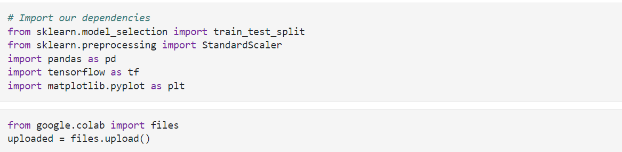
Models
Tried two methods
1st model incorporated Sklearn and made predictions on what bet it on the over/under it thought would win
Used the last 10 games of each team’s performance
2nd model incorporated Sklearn and Tensorflow and made predictions based on the previous game’s Over/Under results

Slide 9
Results
Not as successful as we hoped
1st Model

Slide 10
Conclusions
Sports are hard to predict
Future Considerations
Kelly Criterion
More Team Statistics to use
Weight Hot Streaks in the Model

